Slide 1
MODULE – 8 OBJECT-BASED AND UNIFIED STORAGE
Notes:
Module – 8
Object-Based and Unified Storage

Slide 2
Module 8: Object-based and Unified Storage
Upon completion of this module, you should be able to:
Describe the object-based storage model
List the key components of object-based storage
Describe the storage and retrieval process in object-based storage
Describe content-addressed storage
List the key components of unified storage
Describe the process of data access from unified storage

Slide 3
Module 8: Object-based and Unified Storage
Lesson 1: Object-based Storage
During this lesson the following topics are covered:
Comparison of hierarchical file system and flat address space
Object-based storage model
Key components of object-based storage
Storage and retrieval process in object-based storage devices
Content-addressed storage

Slide 4
Drivers for Object-based Storage
More than 90% of the data being generated is unstructured
Traditional solutions are inefficient to handle the growth
High overhead on NAS due to managing large number of permissions and nested directories
These challenges demanded a smarter approach to manage unstructured data based on its content
Object-based storage is a way to store file data in the form of objects on flat address space based on its content and attributes rather than the name and location

Slide 5

Hierarchical File System Vs. Flat Address Space
Filenames/inodes
Hierarchical file system organizes data in the form of files and directories
Hierarchical File System

Slide 6
Hierarchical File System Vs. Flat Address Space
Object-based storage devices store the data in the form of objects
It uses flat address space that enables storage of large number of objects
An object contains user data, related metadata (size, date, ownership, etc.) and other attributes (retention, access pattern, etc.)
Each object has a unique object ID, generated using specialized algorithm
Object IDs
Object
Object
Object
Object ID
Object
Object
Data
Metadata
Attributes
Object
Object
Flat Address Space

Slide 7
Hierarchical File System Vs. Flat Address Space
More than 90% of the data being generated is unstructured
Traditional solutions are inefficient to handle the growth
High overhead on NAS due to managing large number of permissions and nested directories
These challenges demanded a smarter approach to manage unstructured data based on its content

Slide 8
Traditional Vs. Object-based Storage Model
Application
Application
System Call Interface
System Call Interface
File System User Component
File System User Component
File System Storage
Component
Block Interface
OSD Interface
Network
Block I/O
OSD Storage
Component
Block I/O
Storage
Storage
Block-Level Access
Object-Level Access

Slide 9
Traditional Vs. Object-based Storage Model
Application
Application
System Call Interface
System Call Interface
*hierarchy management
*naming
*user access control
File System User Component
File System User Component
File System Storage
Component
Block Interface
OSD Interface
Network
Block I/O
OSD Storage
Component
Block I/O
Storage
Storage
Block-Level Access
Object-Level Access

Slide 10
Traditional Vs. Object-based Storage Model
Application
Application
System Call Interface
System Call Interface
File System User Component
File System User Component
*maps the files to the physical location on the disk drive
File System Storage
Component
Block Interface
OSD Interface
Network
Block I/O
OSD Storage
Component
Block I/O
Storage
Storage
Block-Level Access
Object-Level Access

Slide 11
Traditional Vs. Object-based Storage Model
Application
Application
System Call Interface
System Call Interface
File System User Component
File System User Component
File System Storage
Component
Block Interface
OSD Interface
Network
*low-level storage and space management functions
*security
*access control
Block I/O
OSD Storage
Component
Block I/O
Storage
Storage
Block-Level Access
Object-Level Access

Slide 12
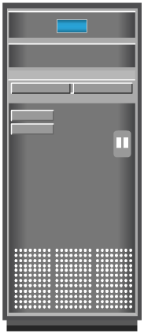



Key Components of Object-based Storage Device
Metadata Server
Metadata Server
Metadata Service
IP
Storage Server
Internal
Network
Storage Server
Storage Service
OSD Node
OSD Node
Application
Server
OSD Nodes
Storage
OSD System
OSD system typically comprises three key components:
OSD nodes
Internal network
Storage

Slide 13
Key Components of Object-based Storage Device
Metadata Server
Metadata Server
*generates object ID
Metadata Service
IP
Storage Server
Internal
Network
Storage Server
Storage Service
OSD Node
OSD Node
Application
Server
OSD Nodes
Storage
OSD System
OSD system typically comprises three key components:
OSD nodes
Internal network
Storage

Slide 14
Key Components of Object-based Storage Device
Metadata Server
Metadata Server
Metadata Service
IP
Storage Server
Internal
Network
Storage Server
*manages sets of disks
Storage Service
OSD Node
OSD Node
Application
Server
OSD Nodes
Storage
OSD System
OSD system typically comprises three key components:
OSD nodes
Internal network
Storage

Slide 15

Process of Storing Object in OSD
2. OSD node divides the file into two parts,
user data and metadata
Metadata Server
Metadata Server
1. Application server sends a file to OSD
Metadata Service
6. Acknowledgment sent to the application server
Storage Server
3. OSD node generates
object ID from the user data
Storage Server
Storage Service
OSD Node
OSD Node
OSD Node
Application
Server
5. OSD stores user data (object)
using the storage service
4. OSD stores metadata and
object ID using the metadata service
Storage

Slide 16
Process of Storing Object in OSD
2. OSD node divides the file into two parts,
user data and metadata
Metadata Server
Metadata Server
1. Application server sends a file to OSD
Metadata Service
6. Acknowledgment sent to the application server
Storage Server
3. OSD node generates
object ID from the user data
Storage Server
Storage Service
OSD Node
OSD Node
OSD Node
Application
Server
5. OSD stores user data (object)
using the storage service
4. OSD stores metadata and
object ID using the metadata service
Storage

Slide 17
Process of Storing Object in OSD
2. OSD node divides the file into two parts,
user data and metadata
Metadata Server
Metadata Server
1. Application server sends a file to OSD
Metadata Service
6. Acknowledgment sent to the application server
Storage Server
3. OSD node generates
object ID from the user data
Storage Server
Storage Service
OSD Node
OSD Node
OSD Node
Application
Server
5. OSD stores user data (object)
using the storage service
4. OSD stores metadata and
object ID using the metadata service
Storage

Slide 18
Process of Storing Object in OSD
2. OSD node divides the file into two parts,
user data and metadata
Metadata Server
Metadata Server
1. Application server sends a file to OSD
Metadata Service
6. Acknowledgment sent to the application server
Storage Server
3. OSD node generates
object ID from the user data
Storage Server
Storage Service
OSD Node
OSD Node
OSD Node
Application
Server
5. OSD stores user data (object)
using the storage service
4. OSD stores metadata and
object ID using the metadata service
Storage

Slide 19
Process of Storing Object in OSD
2. OSD node divides the file into two parts,
user data and metadata
Metadata Server
Metadata Server
1. Application server sends a file to OSD
Metadata Service
6. Acknowledgment sent to the application server
Storage Server
3. OSD node generates
object ID from the user data
Storage Server
Storage Service
OSD Node
OSD Node
OSD Node
Application
Server
5. OSD stores user data (object)
using the storage service
4. OSD stores metadata and
object ID using the metadata service
Storage

Slide 20
Process of Storing Object in OSD
2. OSD node divides the file into two parts,
user data and metadata
Metadata Server
Metadata Server
1. Application server sends a file to OSD
Metadata Service
6. Acknowledgment sent to the application server
Storage Server
3. OSD node generates
object ID from the user data
Storage Server
Storage Service
OSD Node
OSD Node
OSD Node
Application
Server
5. OSD stores user data (object)
using the storage service
4. OSD stores metadata and
object ID using the metadata service
Storage

Slide 21
Process of Retrieving Object from OSD
2. Metadata service locates the object ID for the requested file
1. Application server request file from OSD
Metadata Server
Metadata Server
Metadata Service
3. Metadata service sends the object ID to the application server
Storage Server
4. Application server sends the object ID to the OSD storage service for object retrieval
Storage Server
Storage Service
6. Storage service sends the file to the application server
OSD Node
OSD Node
OSD Node
Application
Server
5. OSD storage service retrieves the object from the storage device
Storage

Slide 22
Process of Retrieving Object from OSD
2. Metadata service locates the object ID for the requested file
1. Application server request file from OSD
Metadata Server
Metadata Server
Metadata Service
3. Metadata service sends the object ID to the application server
Storage Server
4. Application server sends the object ID to the OSD storage service for object retrieval
Storage Server
Storage Service
6. Storage service sends the file to the application server
OSD Node
OSD Node
OSD Node
Application
Server
5. OSD storage service retrieves the object from the storage device
Storage

Slide 23
Process of Retrieving Object from OSD
2. Metadata service locates the object ID for the requested file
1. Application server request file from OSD
Metadata Server
Metadata Server
Metadata Service
3. Metadata service sends the object ID to the application server
Storage Server
4. Application server sends the object ID to the OSD storage service for object retrieval
Storage Server
Storage Service
6. Storage service sends the file to the application server
OSD Node
OSD Node
OSD Node
Application
Server
5. OSD storage service retrieves the object from the storage device
Storage

Slide 24
Process of Retrieving Object from OSD
2. Metadata service locates the object ID for the requested file
1. Application server request file from OSD
Metadata Server
Metadata Server
Metadata Service
3. Metadata service sends the object ID to the application server
Storage Server
4. Application server sends the object ID to the OSD storage service for object retrieval
Storage Server
Storage Service
6. Storage service sends the file to the application server
OSD Node
OSD Node
OSD Node
Application
Server
5. OSD storage service retrieves the object from the storage device
Storage

Slide 25
Process of Retrieving Object from OSD
2. Metadata service locates the object ID for the requested file
1. Application server request file from OSD
Metadata Server
Metadata Server
Metadata Service
3. Metadata service sends the object ID to the application server
Storage Server
4. Application server sends the object ID to the OSD storage service for object retrieval
Storage Server
Storage Service
6. Storage service sends the file to the application server
OSD Node
OSD Node
OSD Node
Application
Server
5. OSD storage service retrieves the object from the storage device
Storage

Slide 26
Process of Retrieving Object from OSD
2. Metadata service locates the object ID for the requested file
1. Application server request file from OSD
Metadata Server
Metadata Server
Metadata Service
3. Metadata service sends the object ID to the application server
Storage Server
4. Application server sends the object ID to the OSD storage service for object retrieval
Storage Server
Storage Service
6. Storage service sends the file to the application server
OSD Node
OSD Node
OSD Node
Application
Server
5. OSD storage service retrieves the object from the storage device
Storage

Slide 27
Key Benefits of Object-based Storage
Benefits | Description
Security and reliability | Unique object ID generated by specialized algorithms ensures data integrity and content authenticity Request authentication is performed at storage device
Platform independence | Because objects are abstract containers of data, it enables sharing of objects across heterogeneous platforms This capability makes object-based storage suitable for cloud computing environment
Scalability | Both OSD nodes and storage can be independently scaled
Manageability | Have inherent intelligence to manage objects Have self-healing capability Policy based management capability enables OSD to handle routine jobs automatically

Slide 28
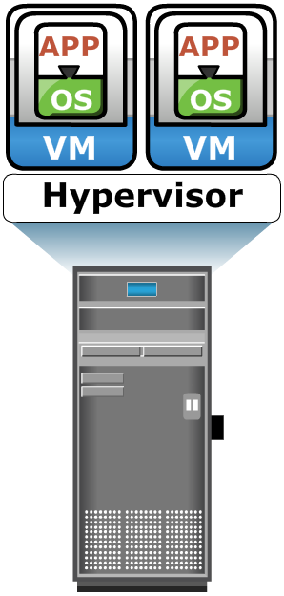
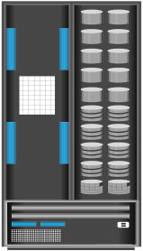




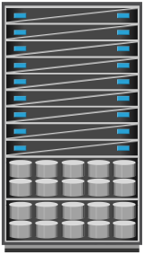
Use Case 1: Cloud-based Storage
Web Application
Thin clients
Content Management
File Sharing
Heterogeneous platforms or tenants accessing
data from cloud storage
HTTP/S (REST, SOAP), NFS, CIFS
REST Representational State Transfer
Global, Intelligent, Web-based, and Self-Service
SOAP
Simple Object Access Protocol
Site #1
Site #2
Site #3
Site #4
Cloud-based Storage

Slide 29
Use Case 2: Content Address Storage (CAS)
Storage designed to store fixed content
Stores data as objects
Each object is assigned a globally unique identifier, known as content address (CA)
CA is derived from the binary representation of the data
CAS device can be accessed via the CAS API running on the application server

Slide 30
Key Features of CAS
Content authenticity and integrity
Location independence
Single instance storage
Retention enforcement
Data protection
Fast record retrieval
Load balancing
Scalability
Self diagnosis and repair
Audit trail and event notification

Slide 31
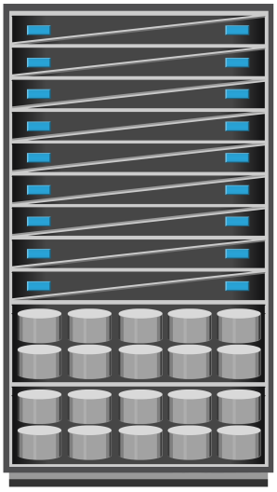
Use Case 1: Healthcare Solution
Hospital
API
Stored locally for
short-term use
(60 days)
Data moved to CAS
(after 60 days)
Patient Records
Application Server
CAS System
Each X-ray image size range from about 15MB to over 1GB
Patient records are stored online for a period of 60 days
Beyond 60 days patient records are archived to CAS

Slide 32
Use Case 2: Financial Solution
Bank
Stored locally for
short-term use
(60 days)
API
Data moved to CAS
(after 60 days)
Application Server
CAS System
Each check image size is about 25KB
Check imaging service provider might process around 90 million check images per month
Checks are stored online for a period of 60 days
Beyond 60 days data is archived to CAS

Slide 33
Module 8: Object-based and Unified Storage
Lesson 2: Unified Storage
During this lesson the following topics are covered:
Key components of unified storage
Data access from unified storage

Slide 34
Drivers for Unified Storage
Deploying disparate storage solutions (SAN, NAS, and OSD) adds management cost, complexity, and environmental overhead
Unified storage consolidates block, file, and object-based access within one unified platform
Supports multiple protocols for data access
Can be managed through single management interface

Slide 35



Components of Unified Storage
Application Servers
NAS Clients
Web Application Servers
Components of unified storage are:
Storage Controller
NAS head
OSD node
Storage
iSCSI/FC/FCoE
CIFS/NFS
REST/SOAP/API
Block Request
File Request
Object Request
NAS Head
OSD Node
Block I/O
Block I/O
Storage Controller
Unified Storage

Slide 36
Components of Unified Storage
Storage controller
Provides block-level access to application servers through iSCSI, FC, or FCoE protocols
Contains iSCSI, FC, and FCoE front-end ports for direct block access
Responsible for managing the back-end storage pool in the storage system
Configures LUNs and presents them to application servers, NAS heads, and OSD nodes
LUNs presented to the application server appear as local physical disks
A file system is configured on these LUNs and is made available to applications for storing data

Slide 37
Components of Unified Storage
NAS head
Dedicated file server that provides file access to NAS clients
Connected to the storage via the storage controller typically using a FC or FCoE connection
Typically has two or more NAS heads for redundancy
The LUNs presented to the NAS head appear as physical disks
The NAS head configures the file systems on these disks, creates a NFS, CIFS, or mixed share, and exports the share to the NAS clients

Slide 38
Components of Unified Storage
The OSD node
Accesses the storage through the storage controller using a FC or FCoE connection
The LUNs assigned to the OSD node appear as physical disks
These disks are configured by the OSD nodes, enabling them to store the data from the web application servers

Slide 39
Data Access from Unified Storage
Application Servers
NAS Clients
Web Application Servers
Block, file, and object requests to the storage travel through different I/O paths.
REST/SOAP/API
iSCSI/FC/FCoE
CIFS/NFS
Block Request
File Request
Object Request
NAS Head
OSD Node
Block I/O
Block I/O
Storage Controller
Unified Storage

Slide 40
Data Access from Unified Storage
Application Servers
NAS Clients
Web Application Servers
Block, file, and object requests to the storage travel through different I/O paths.
REST/SOAP/API
iSCSI/FC/FCoE
CIFS/NFS
Block Request
File Request
Object Request
NAS Head
OSD Node
Block I/O
Block I/O
Storage Controller
Unified Storage

Slide 41
Data Access from Unified Storage
Block I/O request
The application servers are connected to an FC, iSCSI, or FCoE port on the storage controller
The server sends a block request over an FC, iSCSI, or FCoE connection
The storage controller processes the I/O and responds to the application server

Slide 42
Data Access from Unified Storage
Application Servers
NAS Clients
Web Application Servers
Block, file, and object requests to the storage travel through different I/O paths.
REST/SOAP/API
iSCSI/FC/FCoE
CIFS/NFS
Block Request
File Request
Object Request
NAS Head
OSD Node
Block I/O
Block I/O
Storage Controller
Unified Storage

Slide 43
Data Access from Unified Storage
File I/O request
The NAS clients (where the NAS share is mounted or mapped) sends a file request to the NAS head using the NFS or CIFS protocol
The NAS head receives the request, converts it into a block request, and forwards it to the storage controller
Upon receiving the block data from the storage controller, the NAS head again converts the block request back to the file request and sends it to the clients

Slide 44
Data Access from Unified Storage
Application Servers
NAS Clients
Web Application Servers
Block, file, and object requests to the storage travel through different I/O paths.
REST/SOAP/API
iSCSI/FC/FCoE
CIFS/NFS
Block Request
File Request
Object Request
NAS Head
OSD Node
Block I/O
Block I/O
Storage Controller
Unified Storage

Slide 45
Data Access from Unified Storage
Object I/O request
The web application servers send an object request, typically using REST or SOAP protocols, to the OSD node
The OSD node receives the request, converts it into a block request, and sends it to the disk through the storage controller
The controller in turn processes the block request and responds back to the OSD node, which in turn provides the requested object to the web application server

Slide 46
Module 8: Object-based and Unified Storage
Concept in Practice
EMC Atmos
EMC VNX
EMC Centera

Slide 47
EMC Atmos
Massively scalable objects-based storage
Can be deployed in two ways: purpose-built hardware appliance or virtual machine (VM)
Key features
Enable policy-based management
Provide protection with replication and parity
Provide services such as compression and deduplication
Support web service and legacy protocols
REST, SOAP, CIFS, NFS, and Installable File System
Enable automated system management
Supports multitenancy
Flexible administration

Slide 48
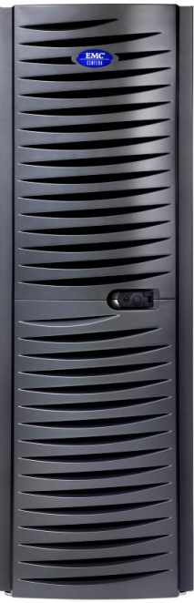
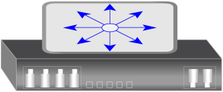

EMC Centera
Storage Nodes
Access Nodes
Private LAN
External LAN
Client
EMC Centera
API
EMC Centera is offered in three different models
EMC Centera Basic
EMC Centera Governance Edition
EMC Centera Compliance Edition Plus (CE+)
Application Server

Slide 49
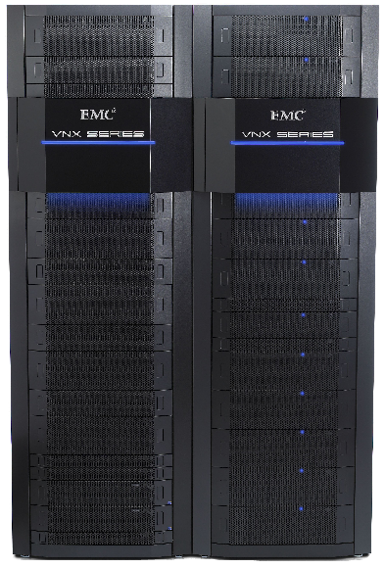
EMC VNX
Unified storage platform that consolidates block, file, and object accesses in one solution
Supports block access via storage processors
File access via X-Blade
Object access via EMC Atmos VE
Components of VNX are:
Storage processor
X-Blade
Control station
Disk-array enclosures
Standby power supply

Slide 50
Module 8: Summary
Key points covered in this module:
Object-based storage model
Key components of object-based storage
Process of storage and retrieval in object-based storage
Content-addressed storage
Key components of unified storage
Process of data access from unified storage

